Slide 1


Chi square test
LEARNING OBJECTIVE
12.2.4.1:Use statistical methods to analyse the reliability
of inheritance of traits ( χ² test)
Accept or reject your null hypothesis.

Slide 2
Vocabulary
KNOW
Null hypothesis, alternate hypothesis, accept, reject, expected, observed, disproved, prove, sum, squared, nullify, critical value, degrees of freedom, significant statistical deviation, probability, by chance.

Slide 3


Slide 4

KNOW
Null Hypothesis
The null hypothesis (H₀)is the commonly accepted fact; it is the opposite of the alternate hypothesis (H_{a}). Researchers work to reject, nullify or disprove the null hypothesis. Researchers come up with an alternate hypothesis, one that they think explains a phenomenon, and then work to reject the null hypothesis.
Why is it Called the “Null”?
The word “null” in this context means that it’s a commonly accepted fact that researchers work to nullify. It doesn’t mean that the statement is null itself!

Slide 5

Example
Not so long ago, people believed that the world was flat.
Null hypothesis, H₀: The world is flat. Alternate hypothesis: The world is round. Several scientists, including Copernicus, set out to disprove the null hypothesis. This eventually led to the rejection of the null and the acceptance of the alternate. Most people accepted it — the ones that didn’t created the Flat Earth Society!. What would have happened if Copernicus had not disproved it and merely proved the alternate? No one would have listened to him. In order to change people’s thinking, he first had to prove that their thinking was wrong.

Slide 6

KNOW
NULL and ALTERNATIVE HYPOTHESIS

Slide 7
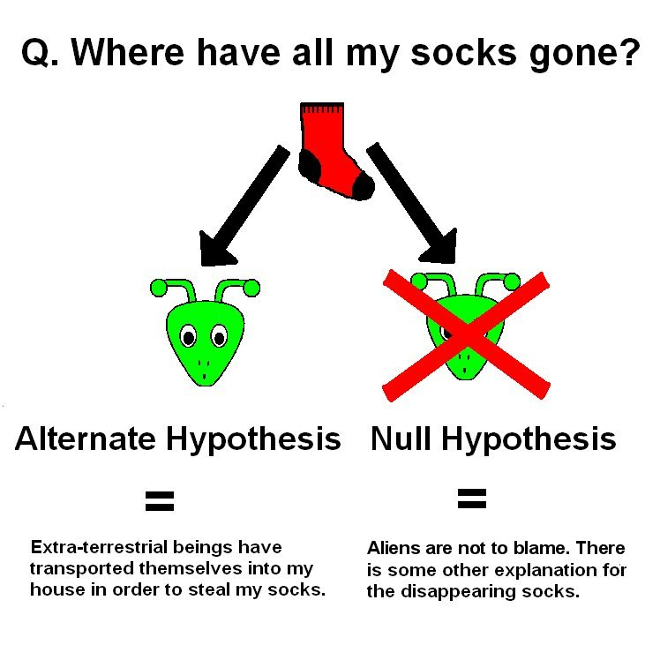
Null hypothesis
KNOW
There is no statistical significant difference between the expected and the observed data.

Slide 8
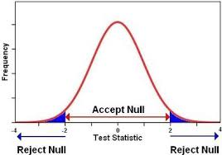
Why do we need the Chi Square test?
KNOW
It is a means of testing if there is any significant statistical deviation between the observed and expected data. Is it by chance or is there a reason?

Slide 9
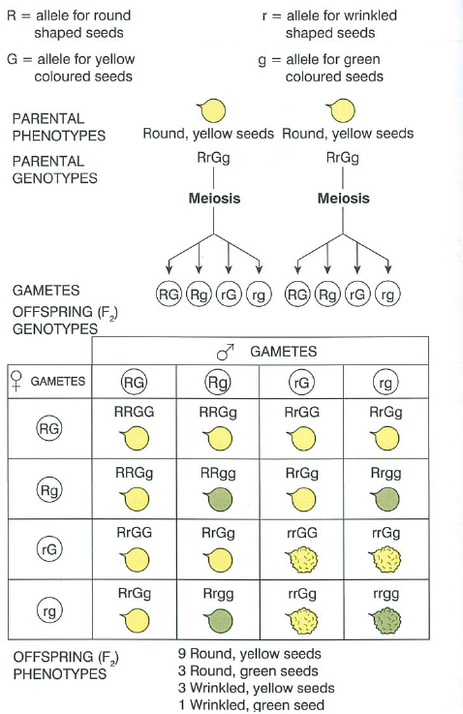
Expected genetic outcomes. Formulate a null hypothesis for each.
Bb x Bb = BB:2Bb:bb = 3:1
Bb X bb = Bb:bb = 1:1
RrGg x RrGg = 9:3:3:1

Slide 10
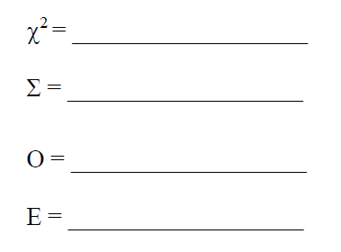

Formula
Will be given – understand how to use.
Chi squared
SUM OF
Observed
Expected

Slide 11
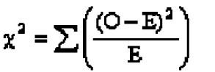
STEPS TO FOLLOW
KNOW STEPS
Formulate null hypothesis.
Sort and organise data into a table with
observed and expected results.
Do the chi square test.
Determine the degrees of freedom. (outcomes – 1)
Determine the critical value. (0.05 column)
If X² is less than critical value accept null hypothesis.
If X² is higher than critical value REJECT null hypothesis.
NB - you have to have at least 2 outcomes to compare to each other
E.g. My X² of 1,2 is less than my critical value of 3,84. I therefore accept my null hypothesis. The data is valid.

Slide 12
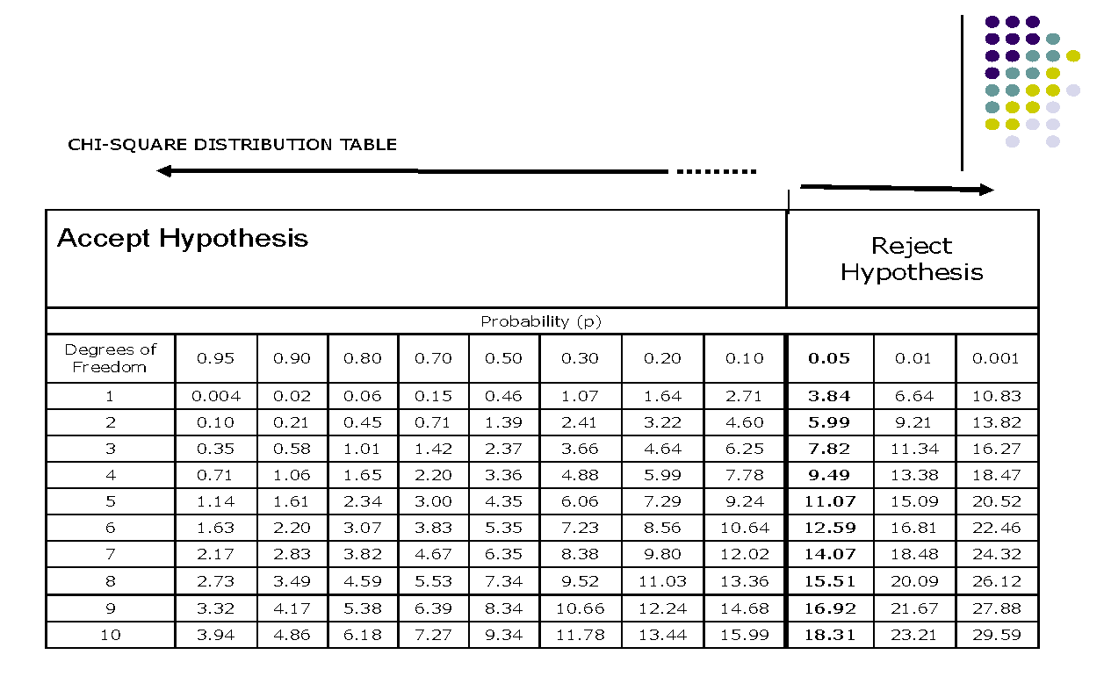
Will be given – understand how to use.

Slide 13
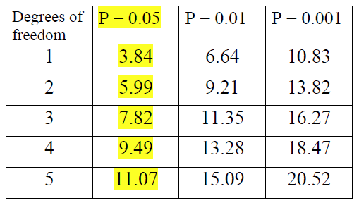
Degrees of freedom (outcomes -1 to determine critical value)
understand
Accept null hypothesis
Reject null hypothesis

Slide 14
The table and X²
KNOW
The critical value that we compare with the X² value gives us the following information:
The probability that the differences between the results we expected and the outcome we observed were due to chance.
If the value of X² is smaller than the critical value (0.05 probability) we can be confident that the differences between the observed and expected results are due to chance. (they are acceptable don’t worry)
If the value of X² is bigger than the critical value (0.05 probability) then we can be 95% confident (sure) that the difference between the observed and expected results is significant (its important) i.e. do the experiments again, there is a problem, worry!.

Slide 15

The best way to learn something is to actually do it…
We will do problem 1 together. Do problem 2-4 independently. Complete for homework.
Useful website for revision: https://www.youtube.com/watch?v=WXPBoFDqNVk
https://www.youtube.com/watch?v=2QeDRsxSF9M

Slide 16
EXAMPLE:
In the dihybrid test cross between homozygous dwarf pea plants with terminal flowers (ttaa) and heterozygous tall pea plants with axial flowers, the 208 offspring were:
Tall with axial flowers= 55
Tall with terminal flowers=51
Dwarf with axial flowers=49
Dwarf with terminal flowers=53
What is meant by the term ‘test cross’?
Use the X2 test to determine whether or not the difference between these observed results and the expected results is significant.
Calculate E= Total no of offspring/ ratio total x predicted ratio
= 208*1/4= 52 or Total no of offspring * (predicted/total)

Slide 17
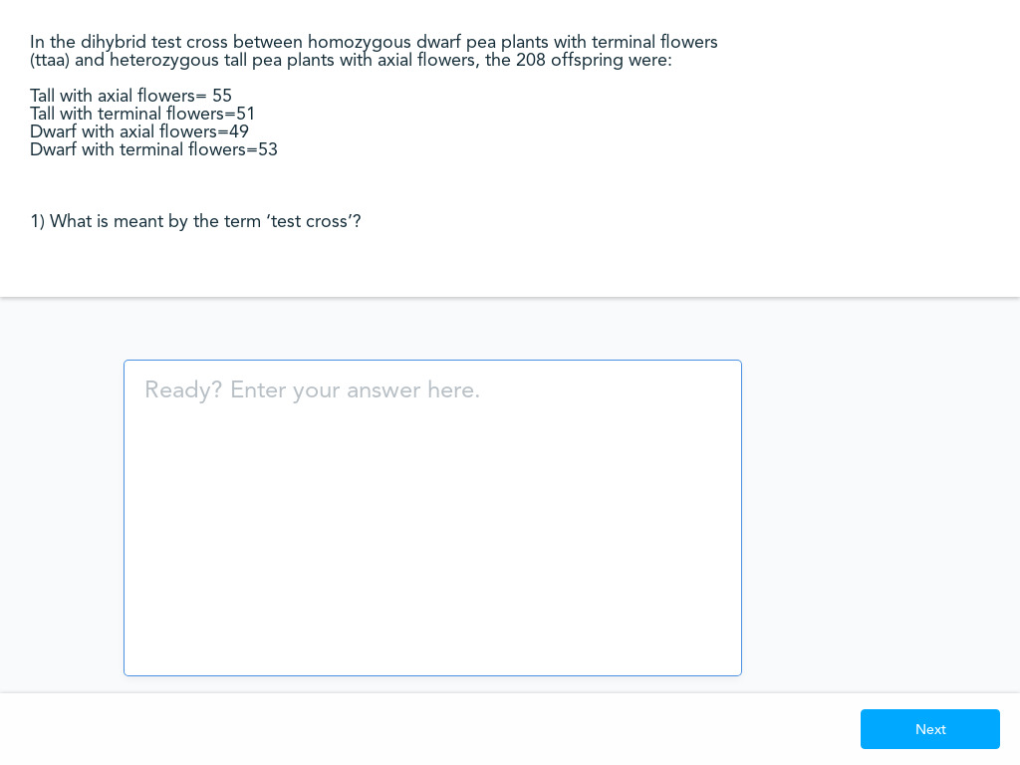

Slide 18
Answers:
It is a genetic cross between a homozygous dominant or and heterozygous dominant and a homozygous recessive. Useful in determining the genotype of the parent showing the dominant phenotype. (Tt or TT).
First calculate X2
Category | Predicted ratio | Observed number, | Expected number, | O-E | (O-E)2 | X2= (O-E)2 E | X2= Σ(O-E)2 E
Tt Aa | 1 | 55 | 52 | 3 | 9 | 0.173
TT aa | 1 | 51 | 52 | -1 | 1 | 0.019
ttAa | 1 | 49 | 52 | -3 | 9 | 0.173
ttaa | 1 | 53 | 52 | 1 | 1 | 0.019 | 0.384
X2 = 0.384

Slide 19
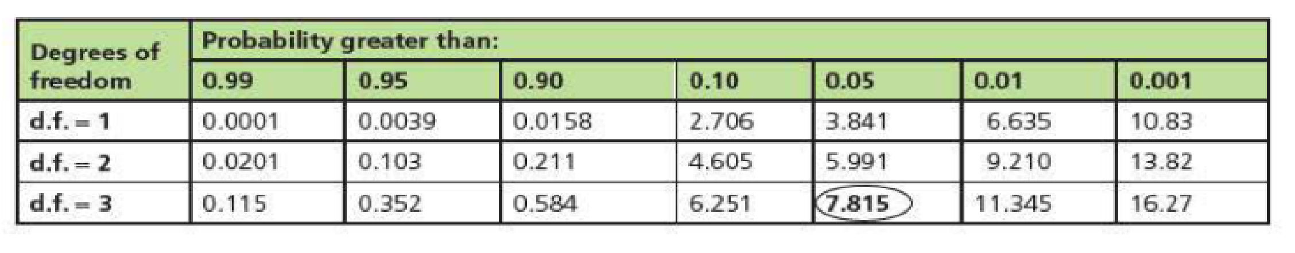
Looking at the table showing the degrees of freedom: (There are 4 categories so n-1= 3 degrees of freedom) P value
The value of X (t-calculated) is smaller than the critical value (t-critical)
Therefore, the differences between observed and expected are due to chance. They are NOT significant.

Slide 20
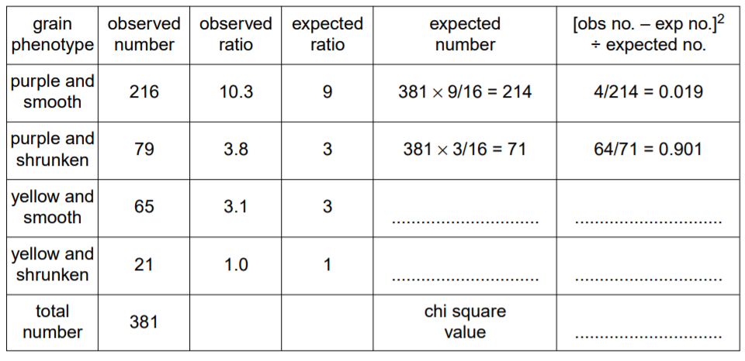
A maize plant produced a total of 381 grains, 216 purple and smooth, 79 purple and shrunken, 65 yellow and smooth and 21 yellow and shrunken.
A chi-squared test, 2 was carried out to test the significance of the differences between the observed and expected results. Complete the table for chi-square.

Slide 21
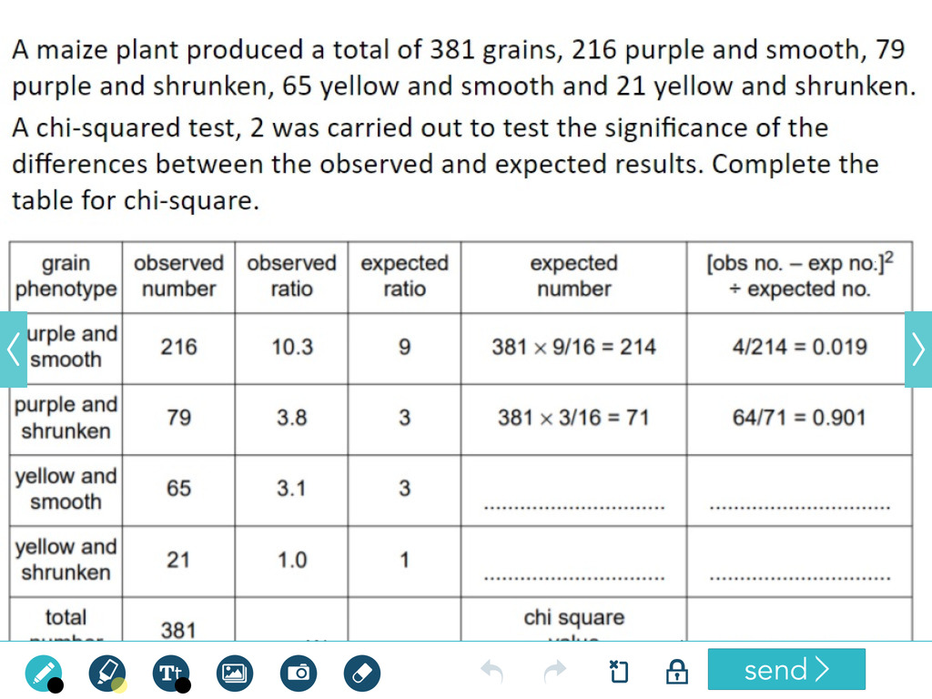

Slide 22
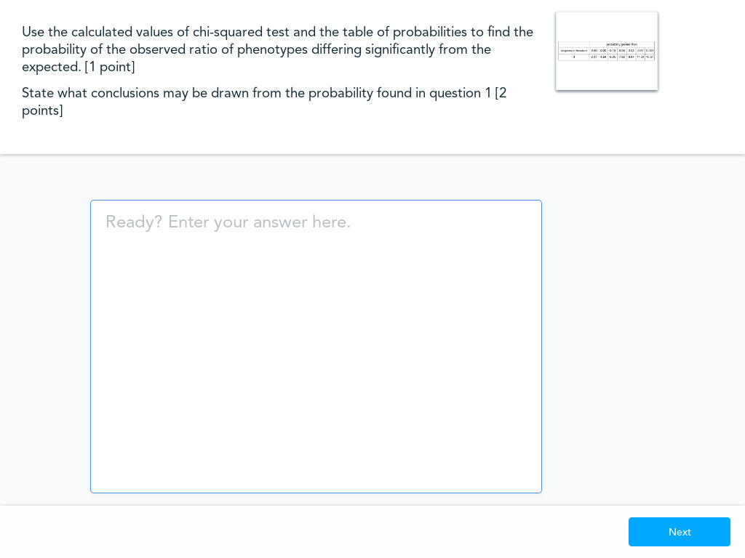

Slide 23
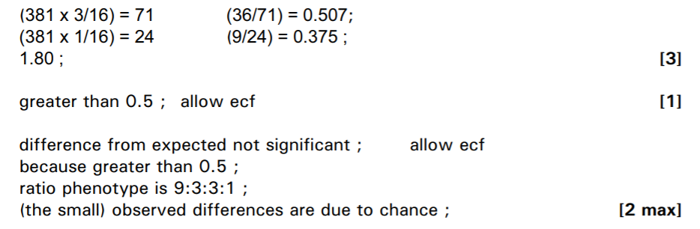
Mark scheme answer:

Slide 24
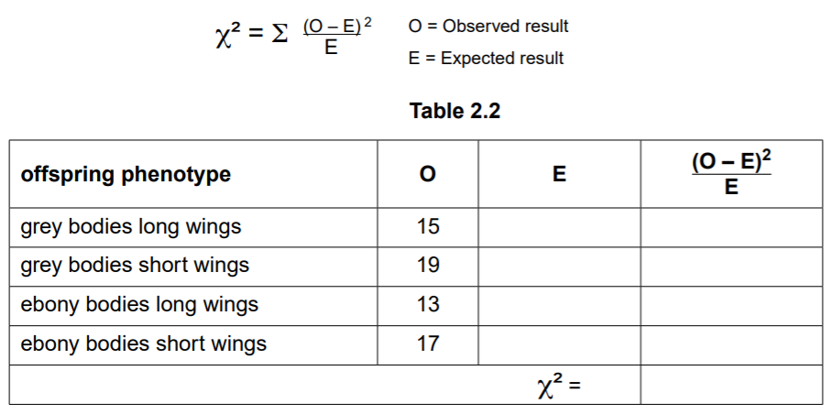
A student used the chi-squared test to analyse results for a cross in fruit flies. The student predicted that the numbers of fruit flies with each phenotype in this cross should be in the ratio 1:1:1:1.
(i) state the null hypothesis for this test [1 point]
……………………………………………………………………………………………………………………………………..
(ii) complete the table [3 points]

Slide 25
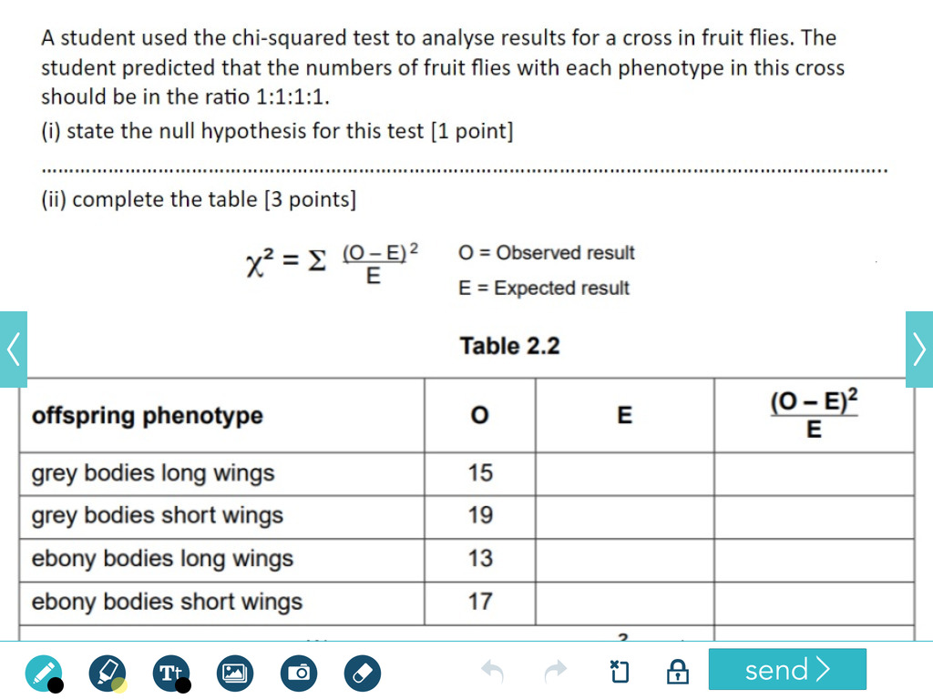


Slide 26
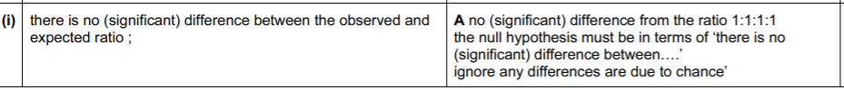
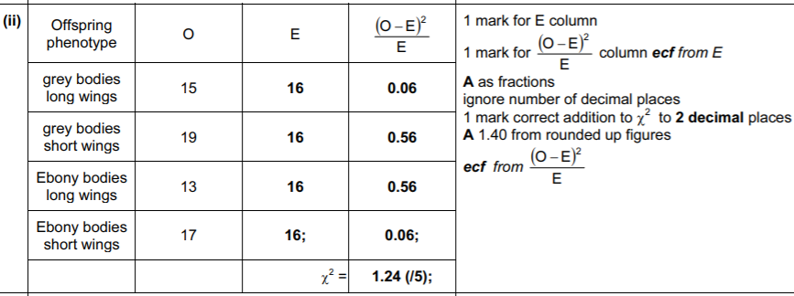
Mark scheme answer:

Slide 27



Slide 28
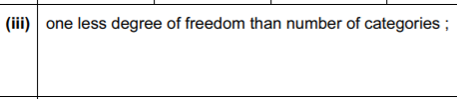
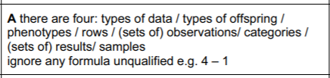

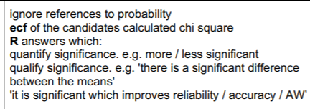
Mark scheme answer:

Slide 29
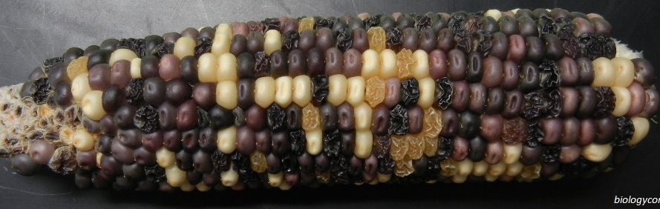
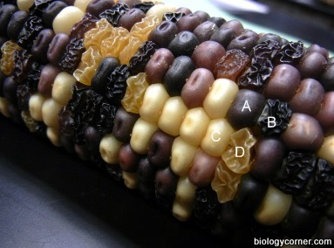
Resource for extra question – Faster students.
1
2
3
4
5

Slide 30
Student’s T- Test
Test the difference between two means.
The t test determines a probability that two populations are the same with respect to the variable tested.
We will revise the T-Test in term 4.
You can watch the following video if you do not want to wait

Slide 31
